Slide 1

Data Science Village
Hands-on Workshop – EDA Part I

Slide 2


Thabor Walbeek
@Thabor09
Thaborwalbeek
https://github.com/DaThabor/DataScienceVillage

Slide 3
Data Sourcing
Where to get data?
First glance at data
Structure, variables and observations
Data Dictionary

Slide 4
Where to get data?
Private Data (e.g. Company Data)
Gathered Data (e.g. IoT devices)
Public Data
Data.gov.in (Indian public government data)
https://ai.google/tools/datasets/
Kaggle
And many more

Slide 5
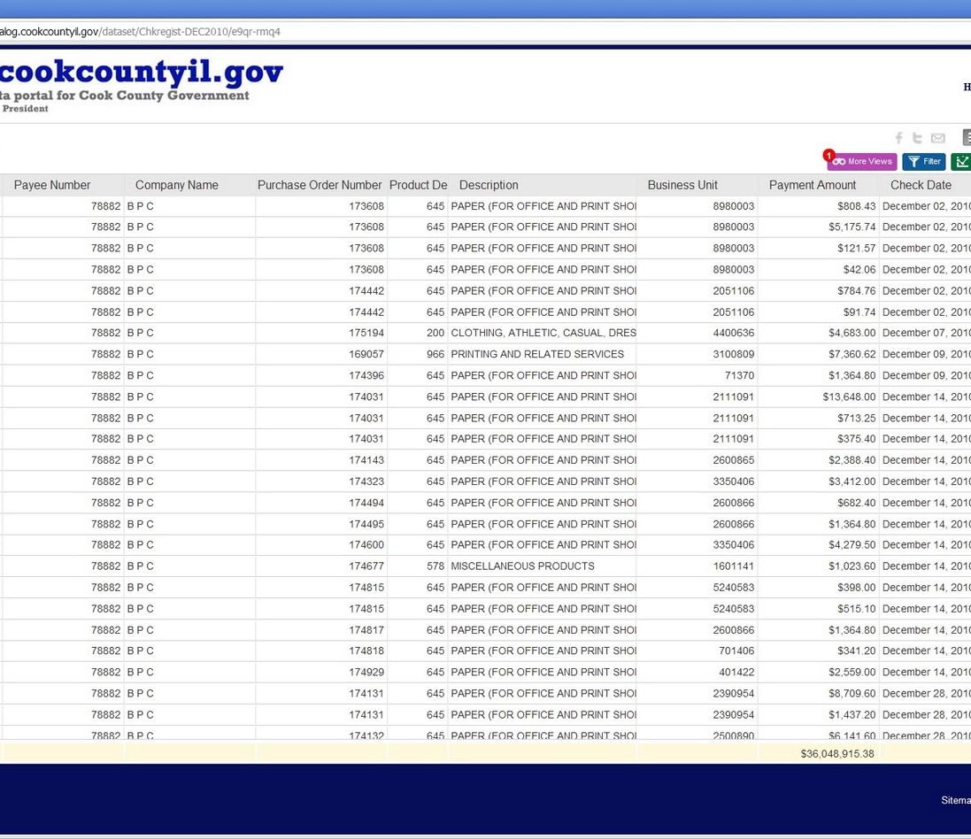
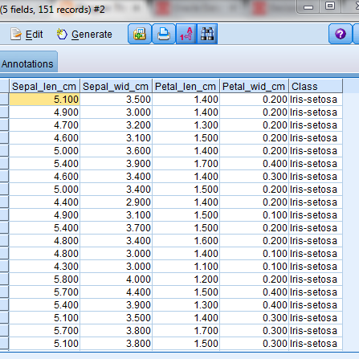
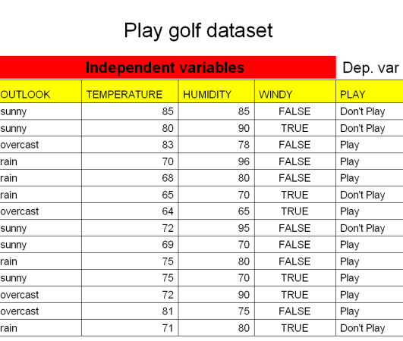
First glance on data
Open the data set to get an idea of what data you’re looking at

Slide 6
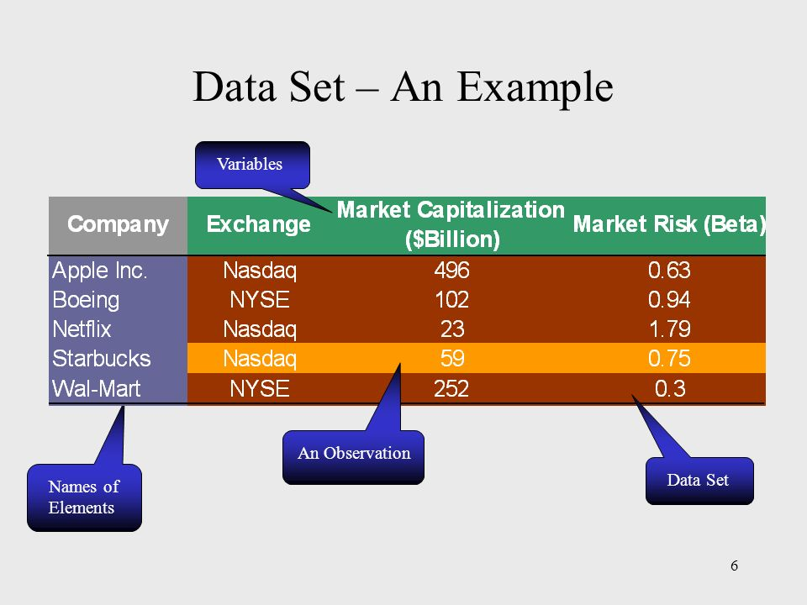
Structure, variables and observations
Structure – what kind of data are you looking at, what data types, what source, etc.
Variables (or features) – How many ‘columns’ does your data set have
Observations – How many ‘rows’ does your data set have

Slide 7
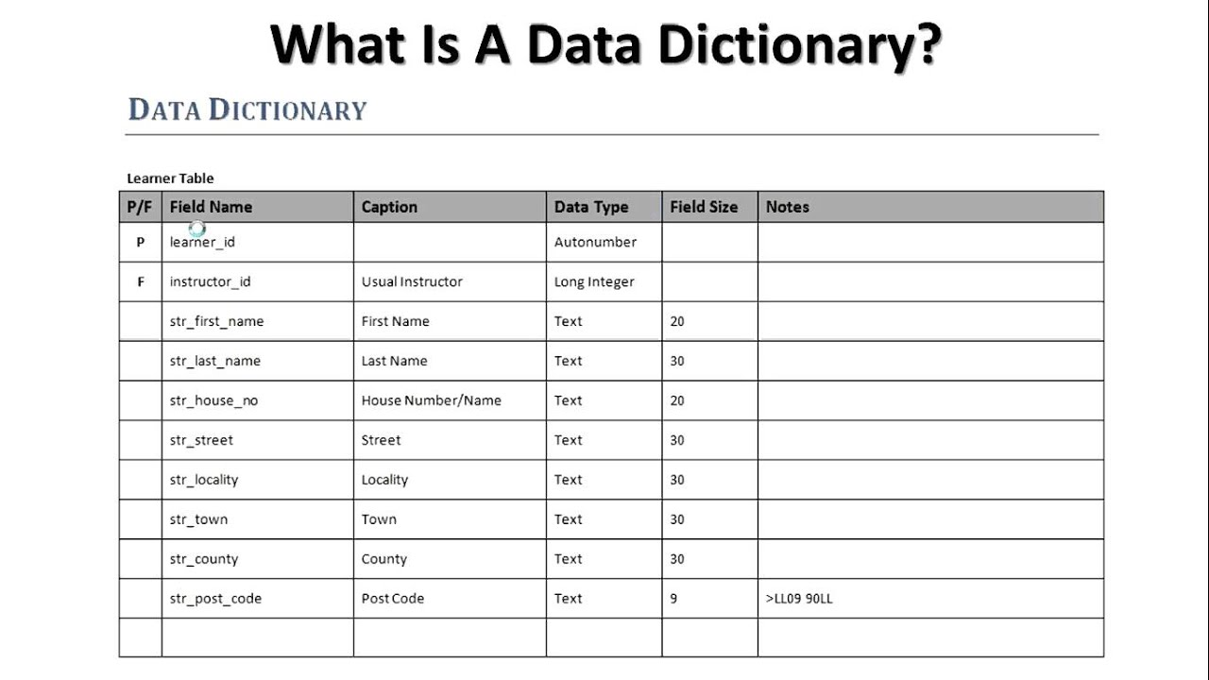
Data Dictionary
A data dictionary, or metadata repository, is a "centralized repository of information about data such as meaning, relationships to other data, origin, usage, and format"

Slide 8

Workshop details
Fixing Rows and Columns
Missing Values
Incorrect Values
Standardizing
Deriving columns
Filtering Data
Mean, Median and Mode
Correlation
Visualization

Slide 9
Exploratory Analysis
In statistics, exploratory data analysis is an approach to analyzing data sets to summarize their main characteristics, often with visual methods. A statistical model can be used or not, but primarily EDA is for seeing what the data can tell us beyond the formal modeling or hypothesis testing task

